Slide 1
Introduction to Functions

Slide 2
OBJECTIVE:
Plot points on the coordinate plane.
Generate points on the coordinate plane.

Slide 3
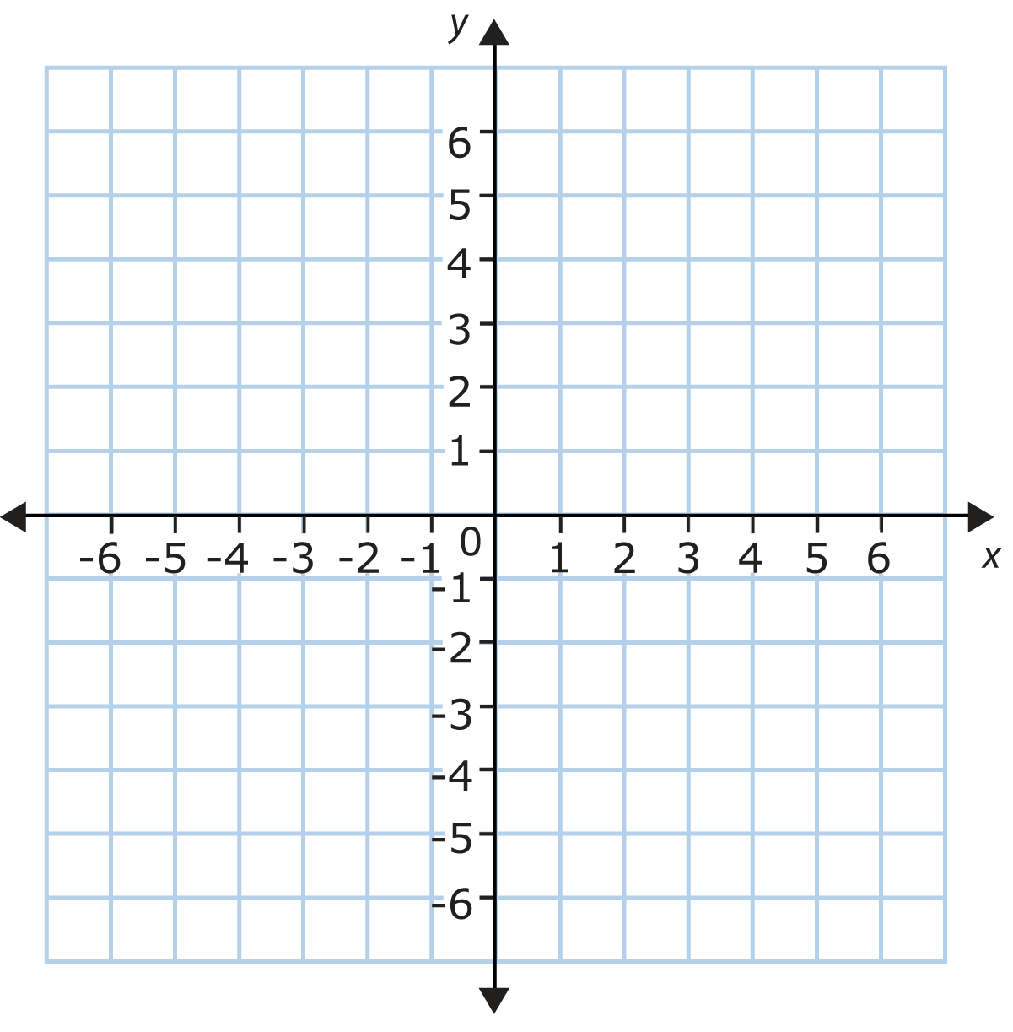
Coordinate Plane
A plane formed by the intersection of two number lines called axes.

Slide 4
Axes
Lines that used as a fixed reference to determine the position of points.

Slide 5
Origin
The point of intersection of the two axes.

Slide 6
X-axis
The horizontal axes that goes from left to right.

Slide 7
Y-axis
The vertical axis that goes up and down.

Slide 8
Ordered Pairs
An ordered pair consists of and x and y coordinate and is written (x,y).
Points are named by capital letters.

Slide 9
X-coordinate
Tells how many units to move to left or right from the origin.
If the x-coordinate is positive, we move to the right. (3, y)
If the x-coordinate is negative, we move to the left. (-2, y)

Slide 10
Y-coordinate
Tells how many units to move up or down from the origin.
If the y-coordinate is positive, we move to the up. (x, 3)
If the y-coordinate is negative, we move to the down. (x, -2)

Slide 11
Graphing ordered pairs
To graph an ordered pair, we move left or right according to the x-coordinate.
We move up or down according to the y-coordinate.

Slide 12
Quadrant
The coordinate plane is divided into 4 quadrants.

Slide 13
Generating Ordered Pairs
Ordered pairs can be generated when we use equations with two variables

Slide 14
Input
We call x-values our inputs.

Slide 15
Output
Y-values are the output.

